Slide 1
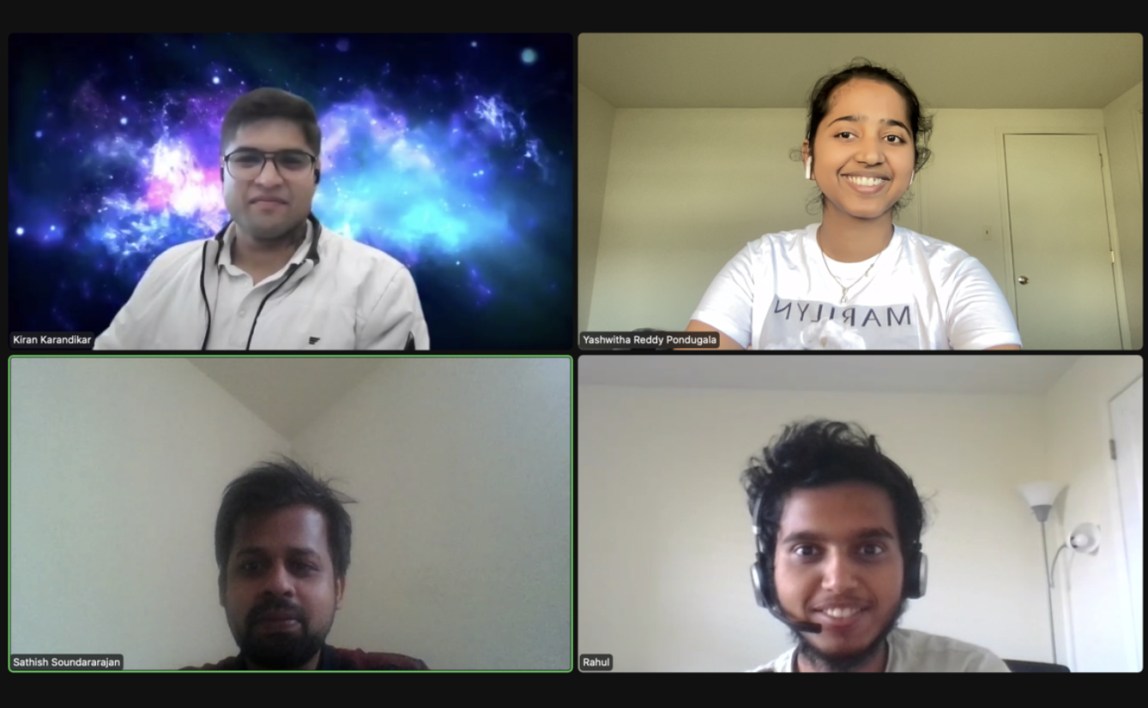
Home Credit Default Risk
Group 02
Kiran Karandikar(kikarand@iu.edu) Sathish Soundararajan(satsoun@iu.edu) Yashwitha Reddy Pondugala(ypondug@iu.edu)
Rahul Gomathi Sankarakrishnan(rgomathi@iu.edu)

Slide 2
Contents
Past developments in Phase 1 and Phase 2
Phase 3 details
Phase 3 results
Conclusion

Slide 3
Past developments
Exploratory Data Analysis
We one-hot encoded all the category features for Feature Engineering
Built a baseline pipeline using logistic regression
Feature Engineering, Hyperparameter tuning and Modelling Pipelines
Using three different models : Decision tree, XGBoost , and random forest.

Slide 4
Phase 3
Classification:
Has 3 layers( 157 input, 64 hidden and 1 ouput)
Uses sigmoid activation function
Regression:
Has 3 layers( 157 input, 64 hidden and 1 ouput)
Uses ReLU activation function
Loss function: Cross Entropy Loss (BCEwithLogitsLoss())
Learning Rate: 0.001
Optimizer: Adam

Slide 5
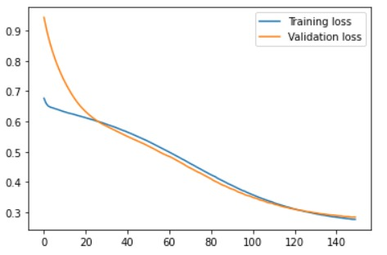
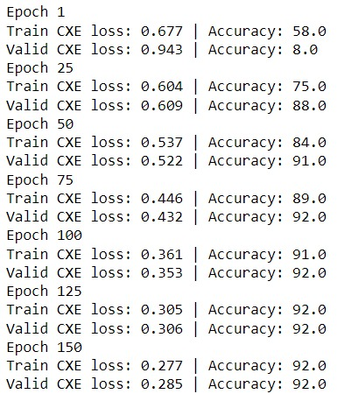

Experiment and Results

Slide 6
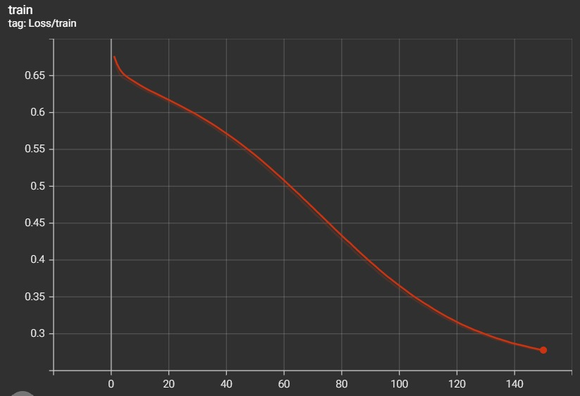
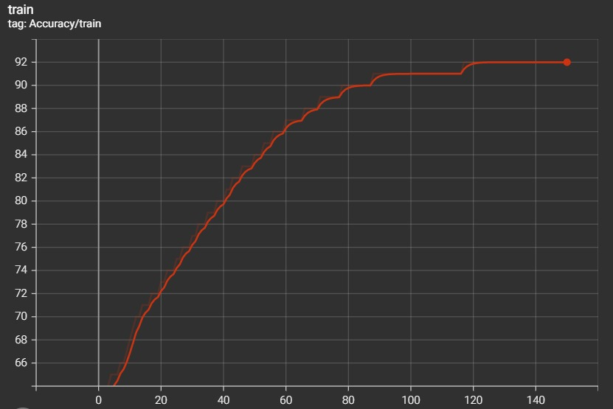
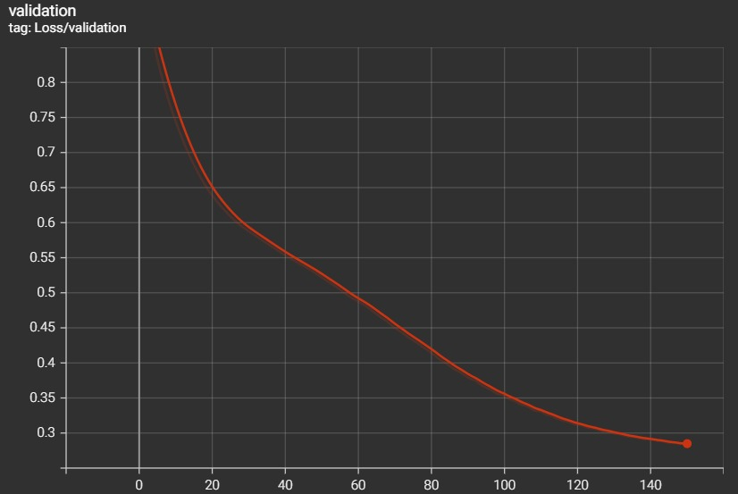
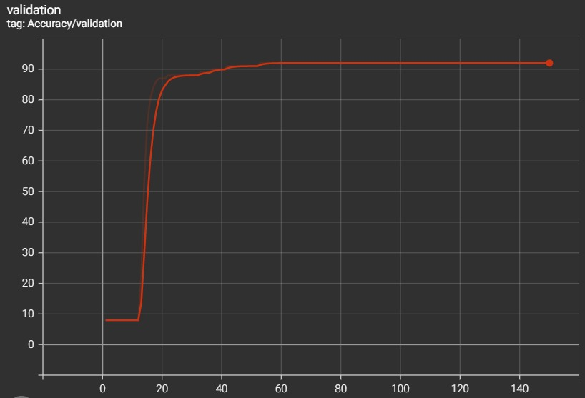
Experiment and Results

Slide 7
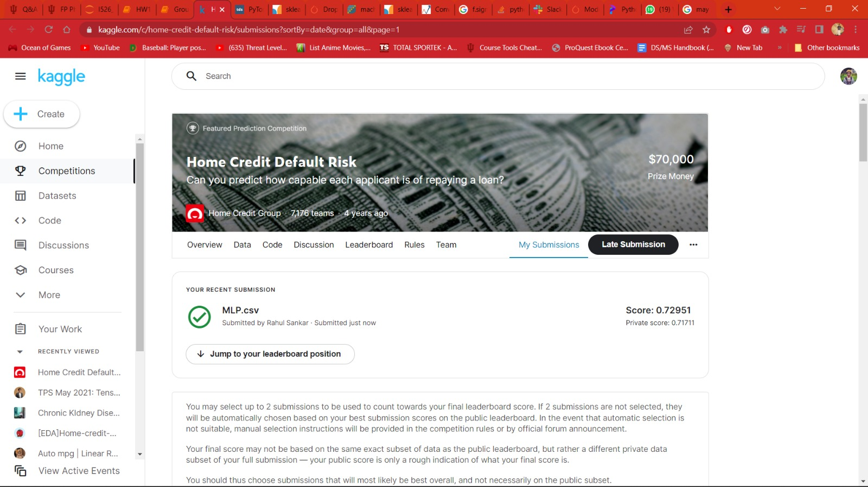
Kaggle Submission:

Slide 8
Conclusion:
In this phase we have built an MLP using PyTorch to determine if the candidate is eligible for loan.
We achieved a test accuracy of 92% with the test loss of 0.29.
Additionally, we have also implemented a MLP model for regression and built a multi headed load default system that combines the loss functions of both the prior models.
Subsequently, we have created a pipeline that incorporates all the three models.

